Slide 1
Setting up Redmine stack on Amazon Linux
Ikuru K

Slide 2
My Env
Name | Version | Installation Method
Apache httpd | 2.2.31 | yum
Ruby | 2.0 | Pre installed
Redmine | 3.1.1 | curl
Passenger | 5.0.20 | gem
MySQL | 5.5.45 | yum

Slide 3
Acknowledgement
All credit goes to this to-the-point post by Mr. Shuji Watanabe! This slide mostly is based on this post with few tweeks.
  http://dev.classmethod.jp/cloud/aws/install-redmine-to-amazon-ec2/

Slide 4
Lets begin
Assume you know how to get your EC2 instance up & running, and then SSHing into the instance.

Slide 5
Get httpd
$ sudo yum install httpd

Slide 6
Get Mysql
$ sudo yum install mysql-server mysql-devel

Slide 7
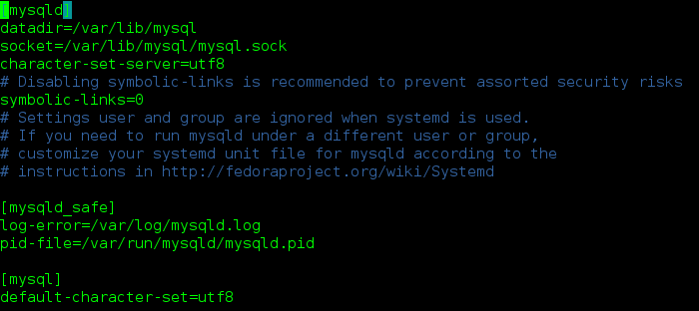
Configure for utf-8 in /etc/my.conf

Slide 8
Start mysqld
$ sudo service mysqld start
$ sudo chkconfig mysqld on

Slide 9
Set up data base for redmine
$ mysql -uroot
mysql> create database db_redmine default character set utf8;
mysql> grant all on db_redmine.* to user_redmine@localhost identified by 'changeit';

Slide 10
Ruby and gem are installed by default, and they work fine
$ ruby -v
ruby 2.0.0p647 (2015-08-18) [x86_64-linux]
$ gem -v
2.4.8

Slide 11
Install packages needed
$ sudo yum groupinstall "Development Tools"
$ sudo yum --enablerepo=epel install ruby-devel mysql-devel ImageMagick ImageMagick-devel ipa-gothic-fonts

Slide 12
Get bundler
$ gem install bundler --no-rdoc --no-ri
Fetching: bundler-1.6.3.gem (100%)
Successfully installed bundler-1.6.3
1 gem installed

Slide 13
Fetch and install redmine
$ curl -O http://www.redmine.org/releases/redmine-3.1.1.tar.gz
$ tar xvf redmine-3.1.1.tar.gz
$ sudo mv redmine-3.1.1 /var/lib/redmine

Slide 14
Install Io-console gem
$ curl -O http://www.redmine.org/releases/redmine-3.1.1.tar.gz
$ tar xvf redmine-3.1.1.tar.gz
$ sudo mv redmine-3.1.1 /var/lib/redmine

Slide 15
Copy database.yml.example to database.yml and write the following
production:
adapter: mysql2
database: db_redmine
host: localhost
username: user_redmine
password: changeit
encoding: utf8

Slide 16
Set up redmine itself
$ cd /var/lib/redmine
$ bundle install --without development test

Slide 17
Create Session secret token
$ bundle exec rake generate_secret_token

Slide 18
Initialize database
$ bundle exec rake db:migrate RAILS_ENV=production

Slide 19
Getting passenger working
Install required packeges
Follow the interactive set up script.
$ sudo yum install curl-devel httpd-devel apr-devel apr-util-devel
$ gem install passenger --no-rdoc --no-ri
$ passenger-install-apache2-module

Slide 20
Put the resulting setting string to /etc/httpd/conf.d/passenger.conf
LoadModule passenger_module /home/ec2-user/.gem/ruby/2.0/gems/passenger-5.0.20/buildout/apache2/mod_passenger.so
<IfModule mod_passenger.c>
PassengerRoot /home/ec2-user/.gem/ruby/2.0/gems/passenger-5.0.20
PassengerDefaultRuby /usr/bin/ruby2.0
</IfModule>

Slide 21
Set the document root for httpd in /etc/httpd/conf/httpd.conf
DocumentRoot "/var/lib/redmine/public”

Slide 22
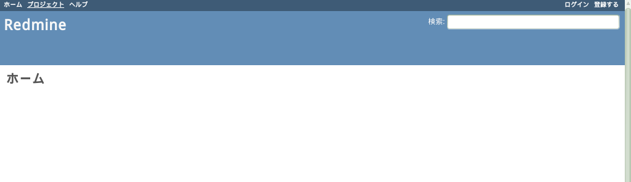
Start the http server, and everything should work after accessing your ip address with a browser.
$ sudo service httpd start
$ sudo chkconfig httpd on

Slide 23
Defaul login
User id = admin
Password = admin

Slide 24
Thank you

